Slide 1
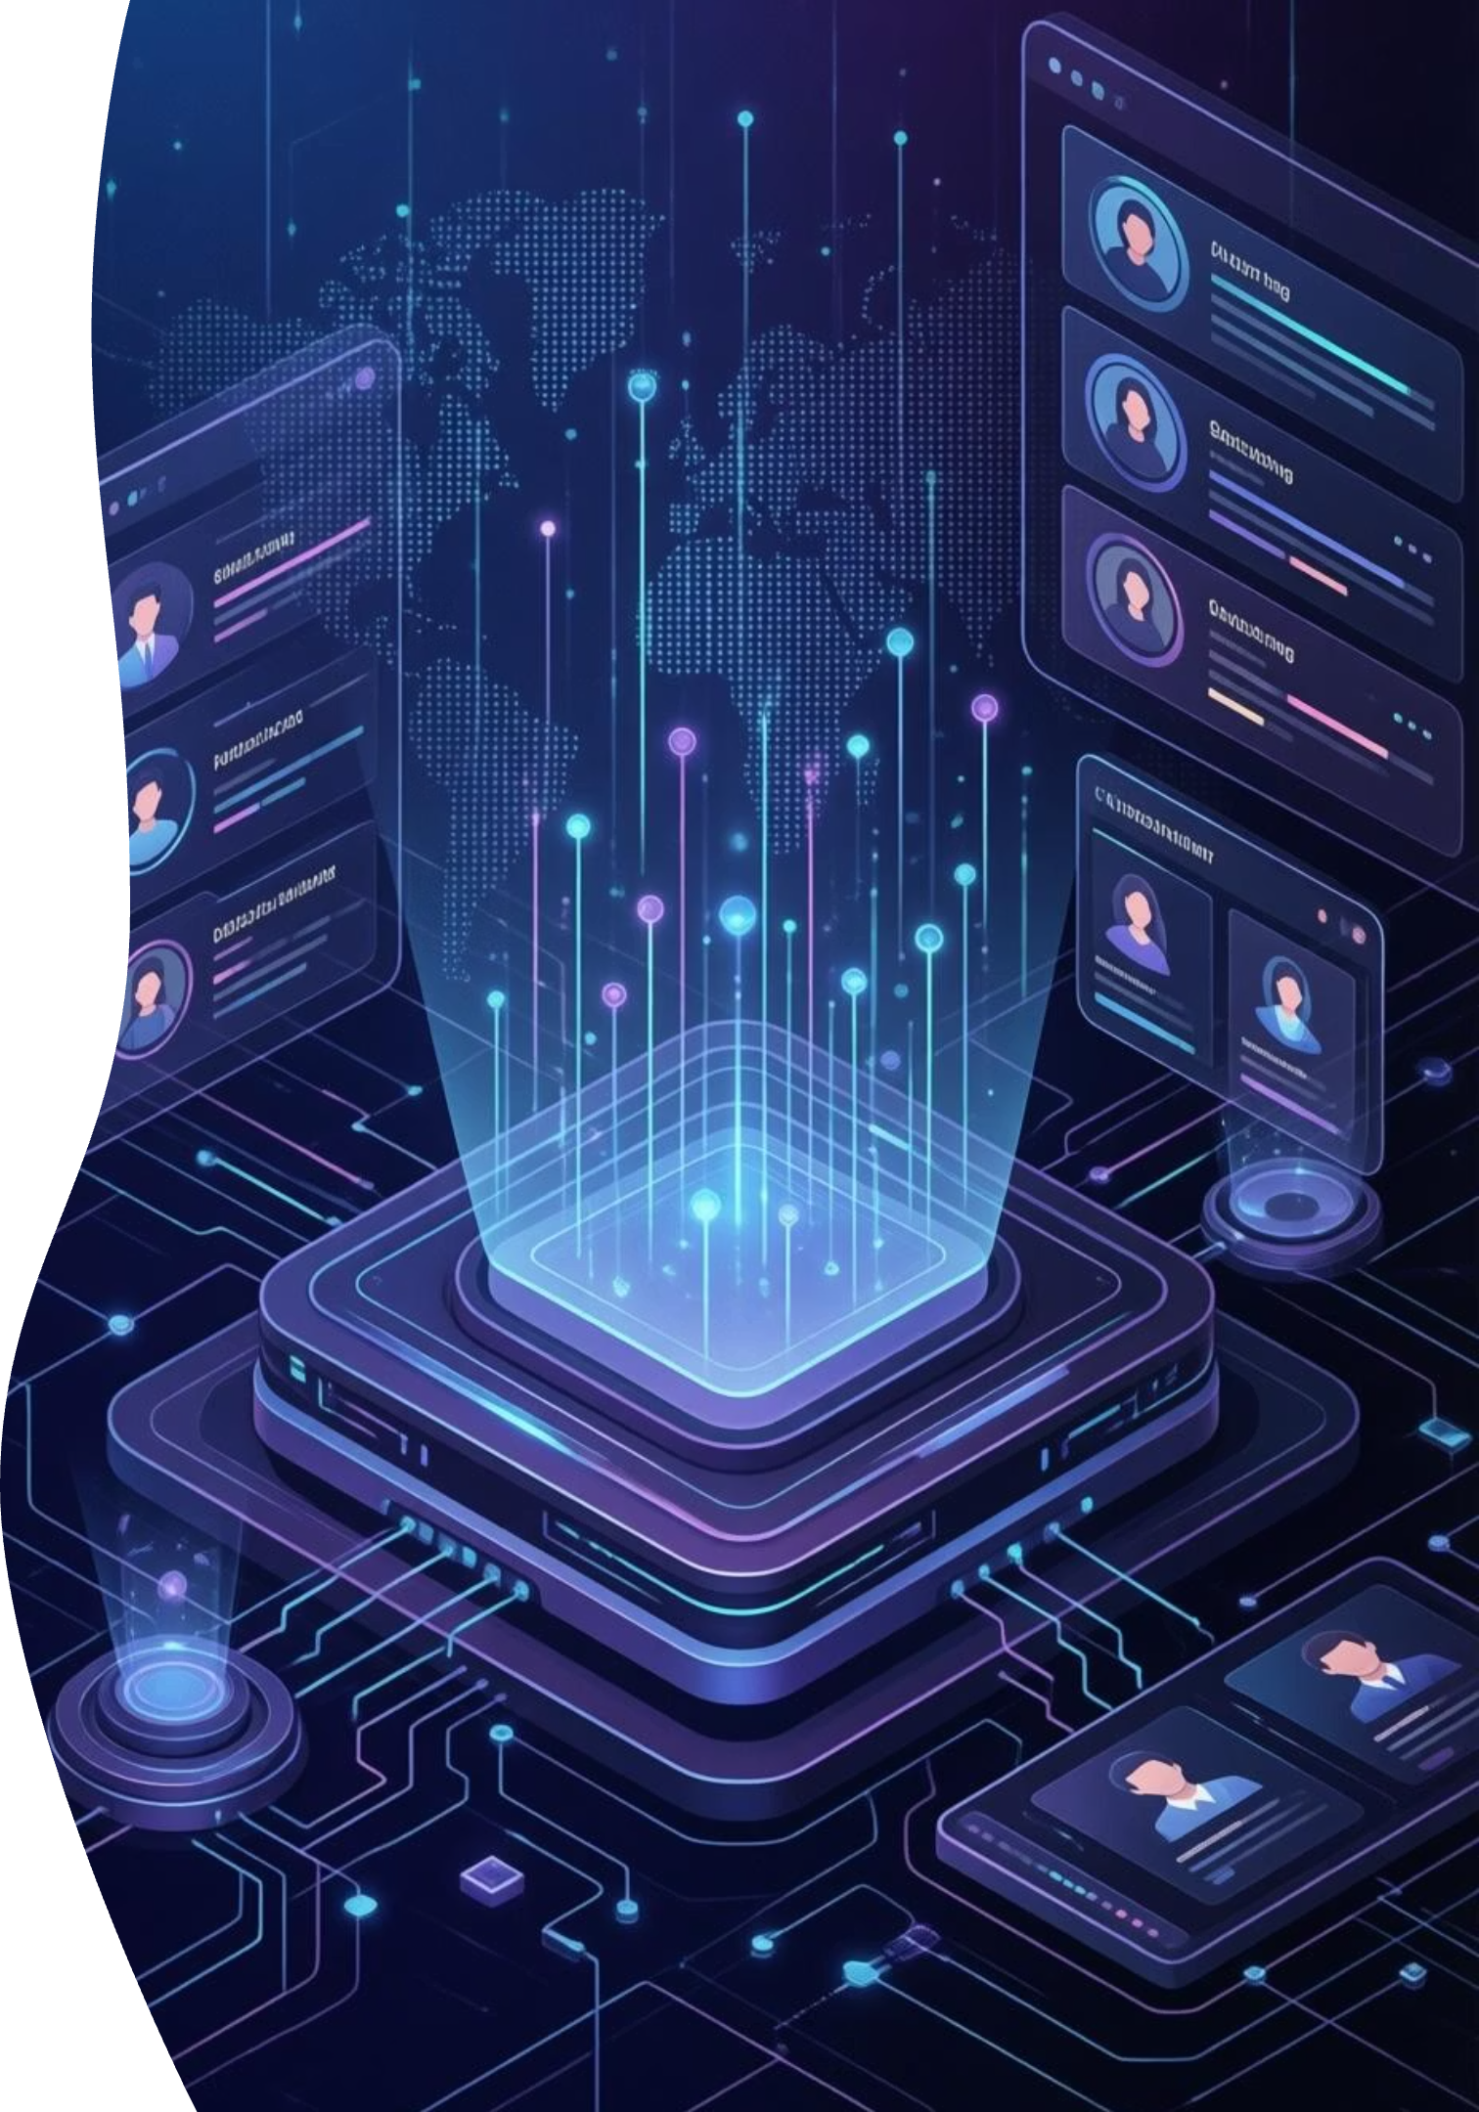
Customer Churn Prediction
End-to-End Machine Learning Project
This project builds an ML system to predict customer churn using structured and unstructured data, aiming to identify at-risk customers and provide actionable retention insights.

Slide 2


🎯 Business Objective: Retain Customers
Predict Churn
Understand Drivers
Identify customers likely to churn before they leave.
Uncover key factors influencing customer churn behavior.
Actionable Insights
Translate model outputs into practical business strategies.

Slide 3

📂 Dataset Overview
Structured Data
Telco Customer Churn Dataset (Kaggle)
Target Variable: Churn (Yes / No)
Features: Demographics, service usage, contract & payment info.
Unstructured Data
Simulated customer feedback text for NLP demonstration.

Slide 4
⚙️ Project Workflow: ML Lifecycle
01
02
03
Data Preprocessing & EDA
Feature Engineering
Model Development
Handling missing values, outliers, and class imbalance.
Encoding, scaling, interaction features, and selection.
Logistic Regression, Random Forest, XGBoost with key metrics.
04
05
06
Model Optimization
Unstructured Text Pipeline
Model Explainability
Hyperparameter tuning and error analysis.
TF-IDF vectorization for text classification.
Feature importance to identify churn drivers.
07
Deployment & System Design
Conceptual design for cloud deployment and monitoring.

Slide 5

🔍 Key Insights from Analysis
Churn Risk Factors
Contract & Payment Impact
Customers with low tenure and high monthly charges are more likely to churn.
Contract type and payment method significantly influence churn behavior.
Class Imbalance
Addressing class imbalance is critical for accurate churn prediction.

Slide 6
🛠️ Tools & Technologies Used
Python
Pandas, NumPy
Core programming language.
Data manipulation and numerical operations.
Scikit-learn
Matplotlib, Seaborn
Machine learning algorithms.
Data visualization.
XGBoost
TF-IDF (NLP)
Advanced gradient boosting.
Text feature extraction.

Slide 7
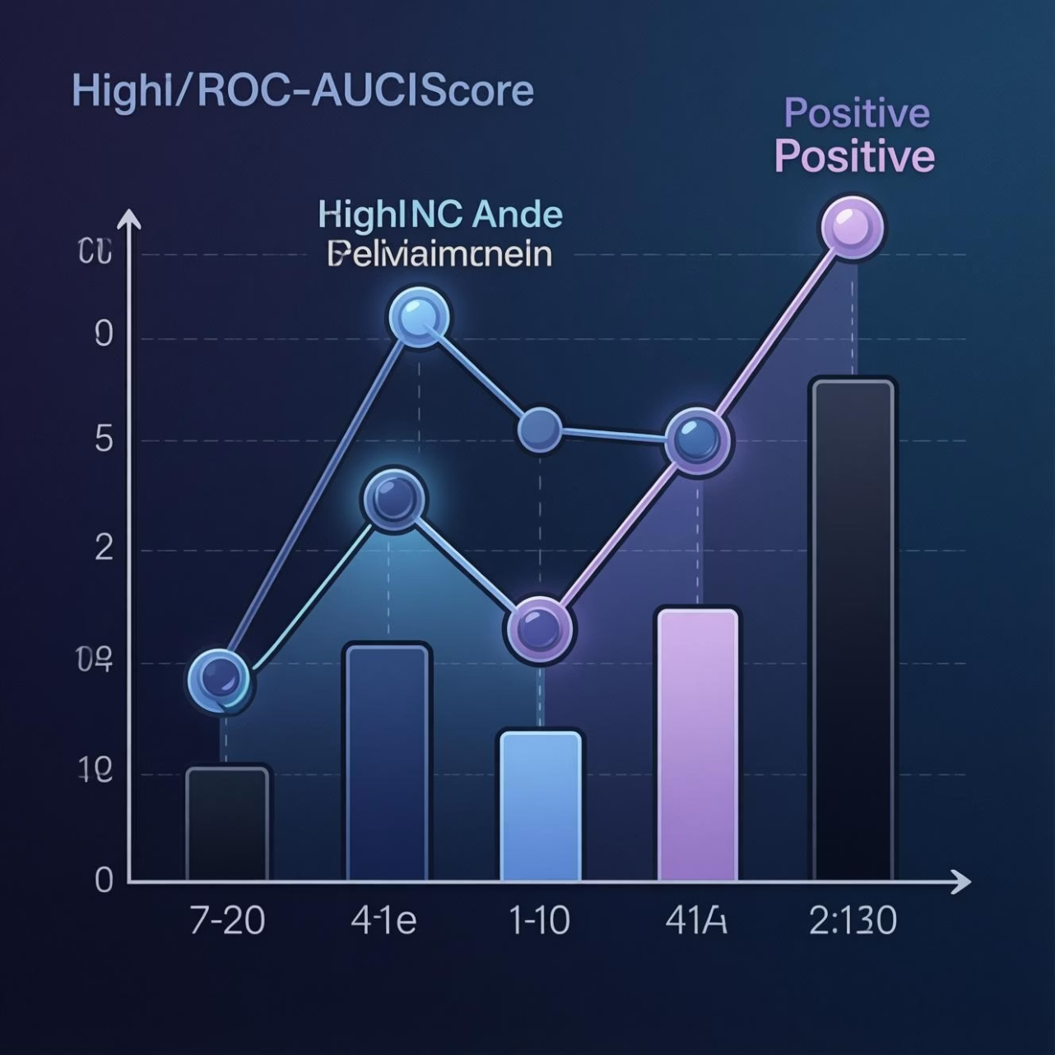
📈 Results Summary
Achieved strong ROC-AUC score on churn prediction.
Random Forest provided the best balance between performance and interpretability.
Feature importance analysis enabled transparent decision-making.
The project successfully built a robust churn prediction model, offering valuable insights for retention strategies.

Slide 8

🚀 Future Enhancements
Real Customer Feedback
Integrate actual customer feedback data for richer insights.
Advanced NLP Models
Explore BERT and other state-of-the-art NLP techniques.
Real-time Deployment
Implement real-time prediction with continuous monitoring.
Automated Retraining
Develop pipelines for automated model retraining to maintain accuracy.

Slide 9
👤 Author
Palepu Veerababu
Aspiring Data Scientist | Data Analyst
Passionate about leveraging data to solve complex business problems and drive informed decisions.

Slide 10

Thank You
We appreciate you taking the time to review our Customer Churn Prediction project. Your attention and insights are invaluable as we strive to leverage data science for business growth. We are eager to discuss any questions you may have.

